Slide 1
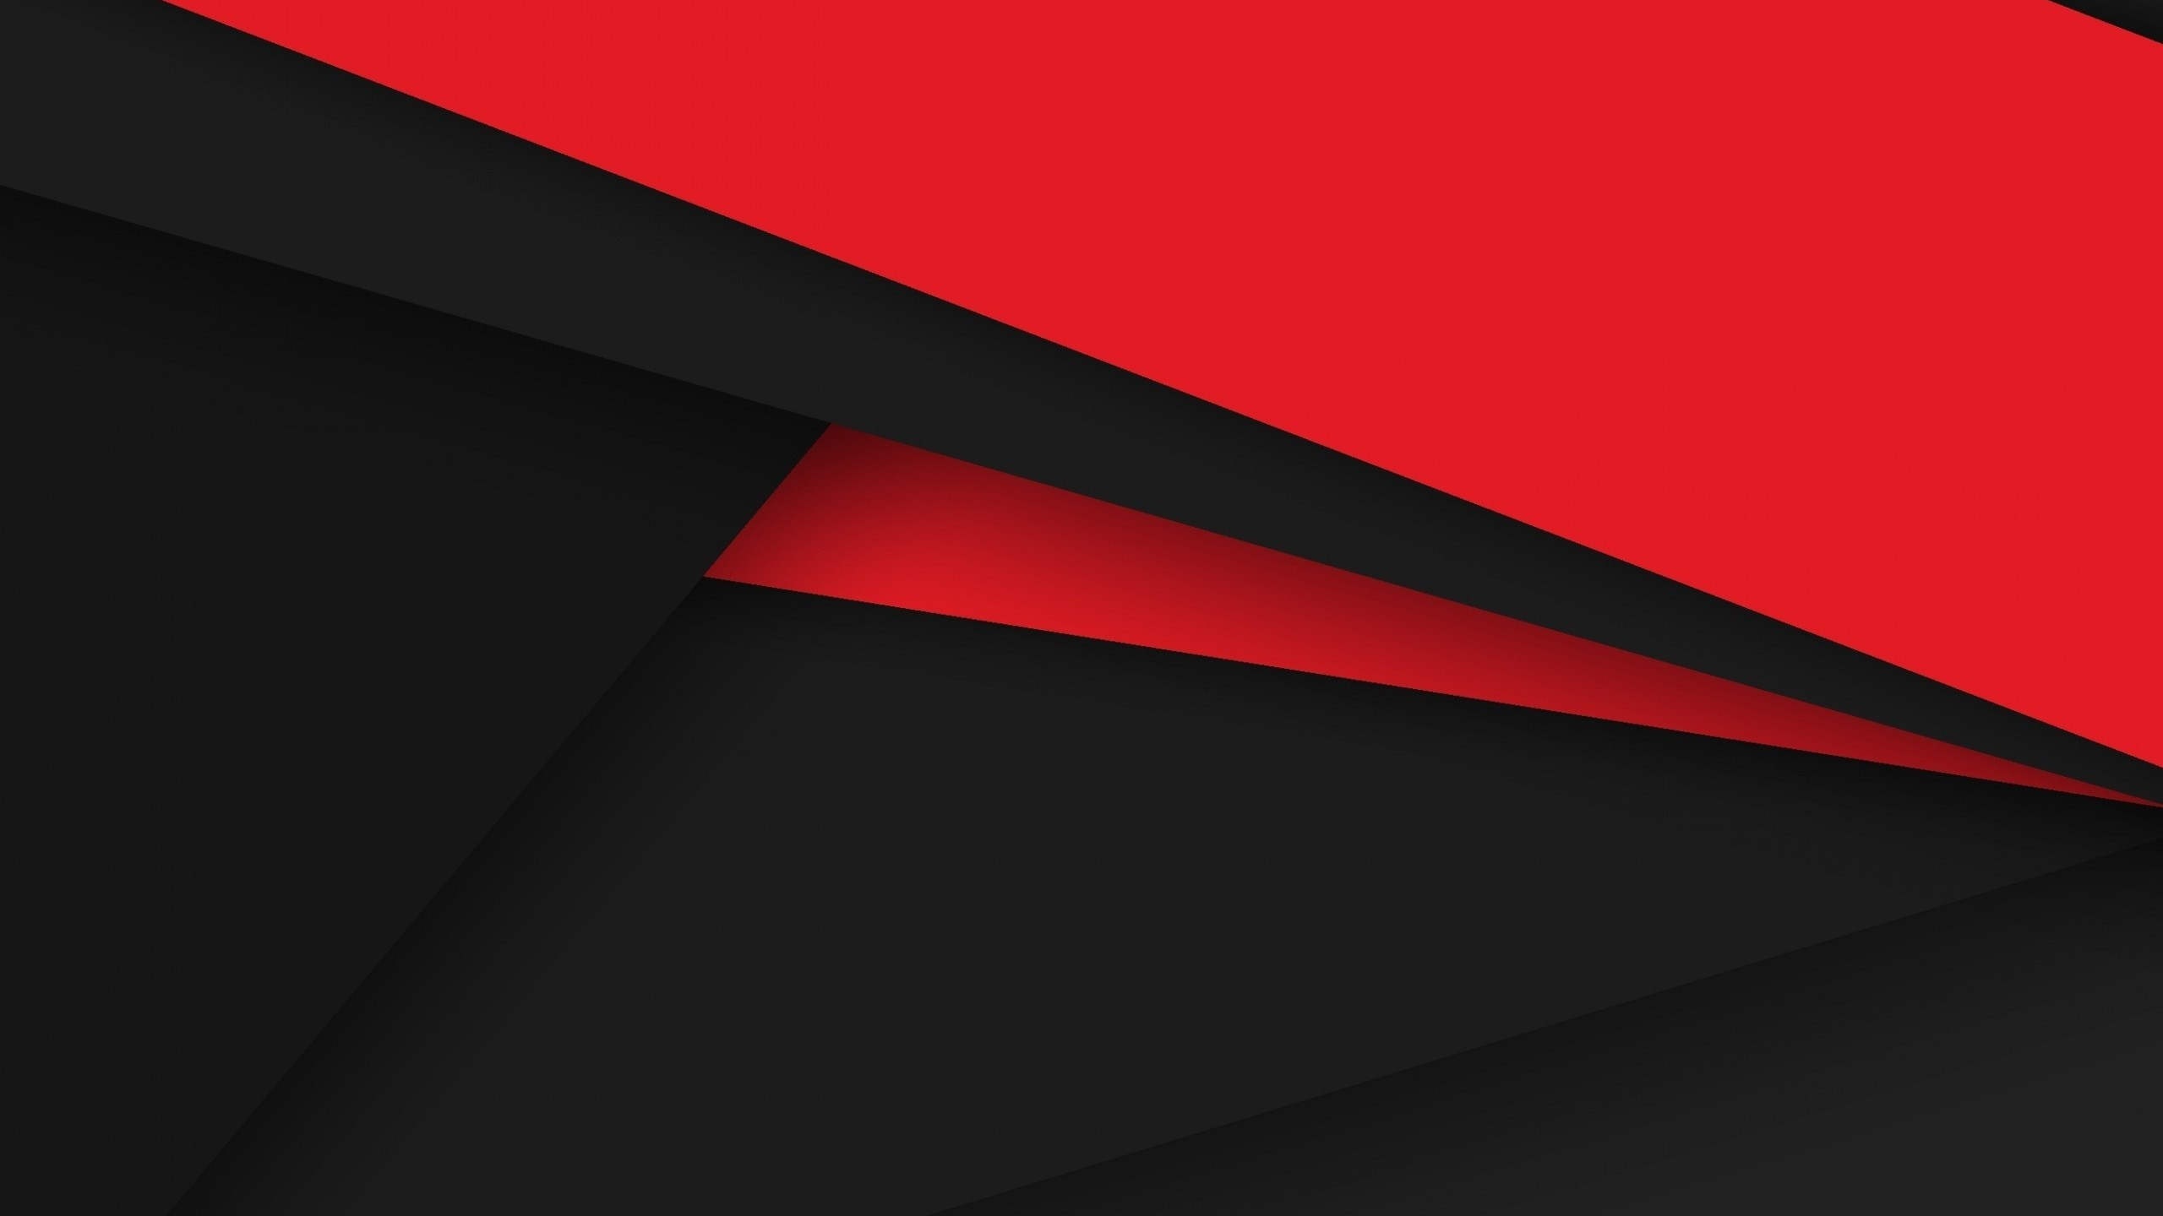
MVC
MODEL-VIEW-CONTROLLER
KAARTHIKEYAN R
(808002)

Slide 2
Model-View-Controller (MVC)
Model–View–Controller (usually known as MVC) is a software design pattern commonly used for developing user interfaces which divides the related program logic into three interconnected elements. This is done to separate internal representations of information from the ways information is presented to and accepted from the user. Following the MVC architectural pattern decouples these major components allowing for code reuse and parallel development.
Traditionally used for desktop graphical user interfaces (GUIs), this pattern has become popular for designing web applications. Popular programming languages like JavaScript, Python, Ruby, PHP, Java, and C# have MVC frameworks that are used in web application development straight out of the box.

Slide 3
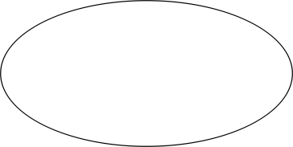
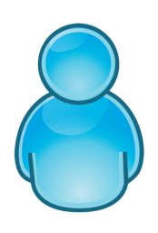
MVC Pattern
SEES
UPDATES
View
Model
User
Controller
USES
MANIPULATES

